Slide 1
CSE3CWA/CSE5006 Cloud-based Web Application
Dr. Choiru Za’in
(TONY: LECTURER)

Slide 2
Oracle Academy (It expires only 12 weeks) Oracle Cloud (IMPORTANT NOTE: Must have a credit card) AWS Academy AWS Cloud

Slide 3
Lecture Topics
Part 1: Cloud Repository and Virtualisation (Week 1,2)
Cloud-based Version Control
Virtual Machine
Containers
Part 2: Web Application Development (Week 3 – 7)
Website and Javascript
Interactive frontend using React Library
Object Relational Mapping (ORM) - Sequelize
API

Slide 4
Lecture Topics
Part 3: AWS Platform (Week 8-11)
AWS Fundamentals
AWS Cloud Infrastructure
AWS Containers
CI/CD in AWS

Slide 5
Individual Assessments
Assessment # | % | Type | Due
1 | 25% | Quiz in LMS (Closed Book) | Week 3 (Part A – 10%) Week 11 (Part B – 15%)-
2 | 25% | Build a web-based application | Week 11
3 | 50% | Paper-based exam (Closed book) | Exam week
Check LMS for the update

Slide 6
Assessments
Assessment 1 (25%)
Assessment 1A (10%) – LMS Quiz, Week 3 (45 mins)
Assessment 1B (15%) – LMS Quiz, Week 11 (60 mins)
Individual - Closed Book
MCQ
Randomised questions
2 attempts are allowed (with the average grade)
Safe Exam Browser must be activated

Slide 7
Assessments
Assessment 2 (25%), Week 11
Develop a fully working cloud-ready web application that has database and ORM, API, and an interactive frontend that is deployed using a container with microservices.

Slide 8
Assessment 3
Paper-based or Online-based examination (TBA)
Exam week
Centrally managed by university
Closed-book & Individual
Contains:
15 MCQ
5 Essays

Slide 9
Academic Integrity
https://latrobe.libguides.com/academic-integrity/what-is-academic-integrity
Academic integrity means putting those values into practice by:
being honest in the academic work you do at university
being fair to others
taking responsibility for learning, and following the conventions of scholarship.
It is the University's responsibility to award credit for honestly conducted work, and it is your responsibility to ensure that you demonstrate academic integrity.

Slide 10
Academic Misconduct
Types of academic misconduct include
plagiarism (copying other people’s work without proper acknowledgement)
collusion (working together on an individual assessment task)
Cheating
All academic misconduct allegation will be processed by Academic Integrity Unit. All marks will be withheld until further notice.
There will be penalties for academic misconduct. https://www.latrobe.edu.au/students/admin/academic-integrity/penalties-for-academic-misconduct

Slide 11
Student Feedback on Subjects (SFS)
It is part of the quality assurance process that occurs across the university.
Students are invited to tell us about your learning experiences in this subject.
Please tell us of your experience in this subject.
Your views will be taken seriously and will assist us to enhance this subject for the next group of students.
Your feedback will also contribute to the text for "Summary of Previous Student Feedback" below so please take the time to tell us your views.
The surveys are anonymous and will be distributed prior to the end of the teaching period.

Slide 12
How to pass this subject (PLEASE!)
Attend Lectures
Complete Lab classes
Some labs might take more than the allocated time.
You should be able to finish them on your own time (outside the session)
Seek help if needed in consultation and ask your lecturer
Although the solutions are provided in the Git repository, it's important to complete the labs yourself to fully understand the process.
Active in the forum LMS, attend the scheduled consultations, and be proactive
Submit assignment (Do not COPY)
Attend exam
Practice… Practice… Practice…

Slide 13
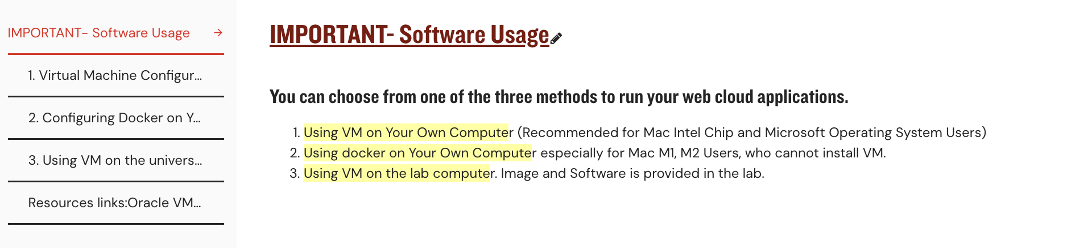
Setting up your environment for this unit
Important to set up your laptop as early as possible (week 1). Please follow the instruction in your LMS, in the section IMPORTANT-software Usage, as follows:

Slide 14
SILO
Upon successful completion of this subject, you should be able to:
Design and Develop web applications using Javascript
Design and build a stateless web server based on cloud technologies
Design and customize backend Web applications based on user requirements
Use modern software engineering tools to build and deploy robust code for scalable web sites.
Investigate storage technologies to determine optimal choice for a web site.

Slide 15
Code repository systems and version control using Git
Week 1

Slide 16
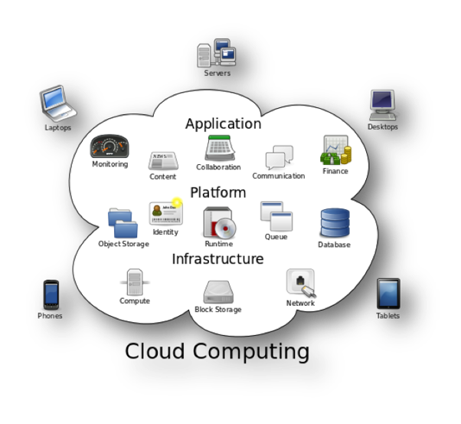
What is Cloud Computing?
The cloud’ → servers that are accessed over the Internet
Cloud servers are located in data centers all over the world.
Users/companies do not have to manage physical servers
Notes:
The cloud' refers to servers that are accessed over the Internet, and the software and databases that run on those servers. Cloud servers are located in data centers all over the world. By using cloud computing, users and companies do not have to manage physical servers themselves or run software applications on their own machines.
'The cloud' started off as a tech industry slang term. In the early days of the Internet, technical diagrams often represented the servers and networking infrastructure that make up the Internet as a cloud. As more computing processes moved to this servers-and-infrastructure part of the Internet, people began to talk about moving to 'the cloud' as a shorthand way of expressing where the computing processes were taking place. Today, 'the cloud' is a widely accepted term for this style of computing.
The cloud enables users to access the same files and applications from almost any device, because the computing and storage takes place on servers in a data center, instead of locally on the user device. This is why a user can log in to their Instagram account on a new phone after their old phone breaks and still find their old account in place, with all their photos, videos, and conversation history. It works the same way with cloud email providers like Gmail or Microsoft Office 365, and with cloud storage providers like Dropbox or Google Drive.

Slide 17
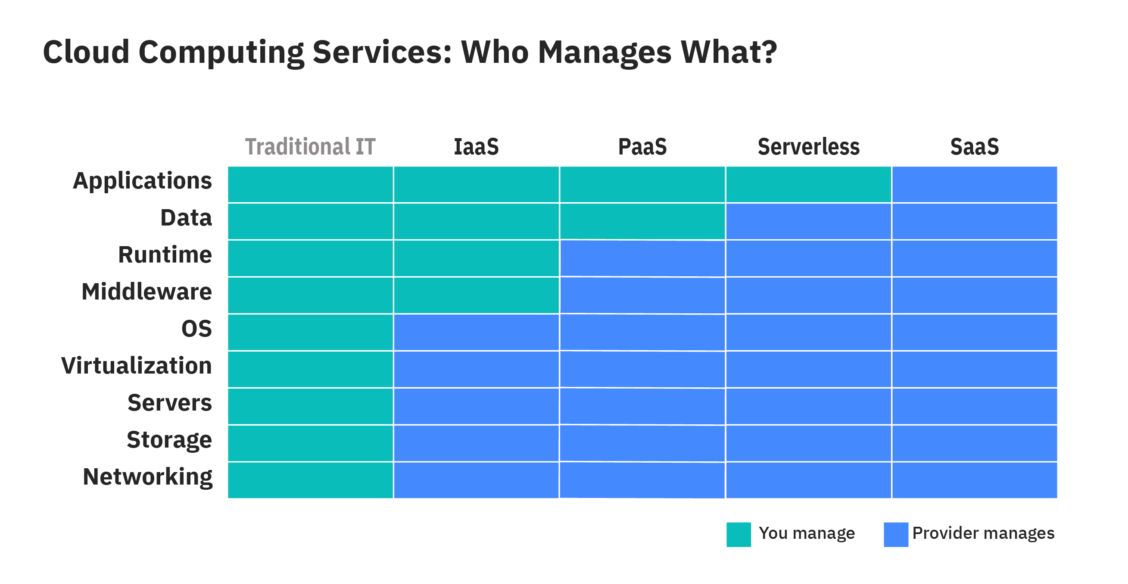
Why do we need cloud computing?
Removes some IT costs and overhead
Easier for companies to operate internationally
Reliability
More contents will be explained in Lecture 10
https://www.ibm.com/au-en/cloud/learn/cloud-computing
Notes:
IaaS (Infrastructure-as-a-Service), PaaS (Platform-as-a-Service) , and SaaS (Software-as-a-Service) are the three most common models of cloud services, and it’s not uncommon for an organization to use all three. However, there is often confusion among the three and what’s included with each:
SaaS (Software-as-a-Service)
SaaS—also known as cloud-based software or cloud applications—is application software that’s hosted in the cloud and that you access and use via a web browser, a dedicated desktop client, or an API that integrates with your desktop or mobile operating system. In most cases, SaaS users pay a monthly or annual subscription fee; some may offer ‘pay-as-you-go’ pricing based on your actual usage
e.g: Google Workspace, Outlook
PaaS (Platform-as-a-Service)
PaaS provides software developers with on-demand platform—hardware, complete software stack, infrastructure, and even development tools—for running, developing, and managing applications without the cost, complexity, and inflexibility of maintaining that platform on-premises.
With PaaS, the cloud provider hosts everything—servers, networks, storage, operating system software, middleware, databases—at their data center. Developers simply pick from a menu to ‘spin up’ servers and environments they need to run, build, test, deploy, maintain, update, and scale applications.
Today, PaaS is often built around containers, a virtualized compute model one step removed from virtual servers. Containers virtualize the operating system, enabling developers to package the application with only the operating system services it needs to run on any platform, without modification and without need for middleware.
Red Hat OpenShift is a popular PaaS built around Docker containers and Kubernetes, an open source container orchestration solution that automates deployment, scaling, load balancing, and more for container-based applications.
IaaS (Infrastructure-as-a-Service)
IaaS provides on-demand access to fundamental computing resources–physical and virtual servers, networking, and storage—over the internet on a pay-as-you-go basis. IaaS enables end users to scale and shrink resources on an as-needed basis, reducing the need for high, up-front capital expenditures or unnecessary on-premises or ‘owned’ infrastructure and for overbuying resources to accommodate periodic spikes in usage.
In contrast to SaaS and PaaS (and even newer PaaS computing models such as containers and serverless), IaaS provides the users with the lowest-level control of computing resources in the cloud.
IaaS was the most popular cloud computing model when it emerged in the early 2010s. While it remains the cloud model for many types of workloads, use of SaaS and PaaS is growing at a much faster rate.
Serverless computing
Serverless computing (also called simply serverless) is a cloud computing model that offloads all the backend infrastructure management tasks–provisioning, scaling, scheduling, patching—to the cloud provider, freeing developers to focus all their time and effort on the code and business logic specific to their applications.

Slide 18
Code Repository and Version Control

Slide 19
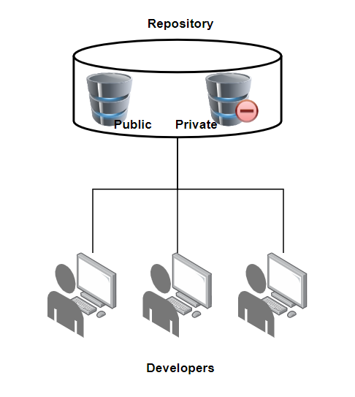
Code Repository
Centralised storage for the source code and other related materials
Main aim is for safekeeping
Stored for public/private access
Notes:
1. What is a code repository?
© 2022 by Bitbucket. Code Cabinet
Developing software requires collaboration between different engineering teams. When one or more people are collaborating on a piece of code or a feature/s in the software, it is important for them to share their work. This work is committed to a central repository (imagine this as a centralized location where all your team’s code is stored).
A source code repository, or simply code repository, is essentially a file archive and web hosting facility where programmers, software developers, and designers store large amounts of source code for the software and/or web pages for safekeeping.
These source codes are kept in repositories that can be either public or private. They are commonly used by open-source software developers for individual or team development projects, as well as to handle various program versions.
The code repository offers the engineering team a centralized location to store all their code, allows individuals/teams to clone the repository from the cloud to their local machine and push and pull the latest code from the repository thus minimizing the effort to share data between different parties.
When a new team member joins the development team, he/she/they can be provided access to the repository using their email or username.

Slide 20
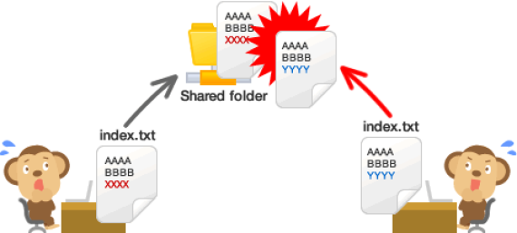
Version Control: Why Use it?
Collaboration
Imagine a team of people are working on the same set of files.
If two people change the same file at the same time, then there will be inconsistencies.
People will be overwriting each others changes.
Notes:
● Using a VCS everybody on the team can work absolutely freely on any file at any time.
● The VCS will later allow you to merge all the changes into a common version
● There is no question where the latest version of a file or the whole project is. It is in a common, central place; your VCS.

Slide 21
Why use a VCS?
A “time machine” → going back to an old version
There is only one active project/version. Everything else (all previous versions) are neatly packed up inside the VCS.
Understanding what happened
Description for every changes
Backup
In the case of distributed VCS such as Git, every team member has a full-blown version of the project on his disk including the project’s complete history.
So even if your central server breaks down you can still get a copy from your teammates local Gitrepository.
Notes:
Going back to an old version
●
Imagine you have a good initial working project. Then you want to make some further changes. You can commit your initial working project into the VCS and continue working on your changes.
●
If you mess things up, you can easily go back to the originally committed version.
●
Using a VCS you can just store the updated files when committing a project into the VCS. The system will automatically find the updated files.
●
Using a VCS you can easily find out what is different between the different versions.
●
A VCS acknowledges that there is only one project. Therefore, there’s only the one version on your disk and that you’re currentlyworking on. Everything else (all previous versions) are neatly packed up inside the VCS.

Slide 22
Benefit of VCS
A complete long-term change history of every file
This means every change made by many individuals over the years. Changes include the creation and deletion of files as well as edits to their contents.
Branching and merging
Creating a 'branch' in VCS tools keeps multiple streams of work independent from each other while also providing the facility to merge that work back together, enabling developers to verify that the changes on each branch do not conflict.
Traceability
Being able to trace each change made to the software and connect it to project management and bug tracking software such as Jira, and being able to annotate each change with a message describing the purpose and intent of the change
Notes:
3. Benefits of version control systems
Version Control Systems (VCS) have seen great improvements over the past few decades and some are better than others. VCS are sometimes known as SCM (Source Code Management) tools or RCS (Revision Control System). One of the most popular VCS tools in use today is called Git. Git is a Distributed VCS, a category known as DVCS, more on that later. Like many of the most popular VCS systems available today, Git is free and open source. Regardless of what they are called, or which system is used, the primary benefits you should expect from version control are as follows.
A complete long-term change history of every file
This means every change made by many individuals over the years. Changes include the creation and deletion of files as well as edits to their contents. Different VCS tools differ in how well they handle the renaming and moving of files. This history should also include the author, date and written notes on the purpose of each change. Having the complete history enables going back to previous versions to help in root cause analysis for bugs and it is crucial when needing to fix problems in older versions of software. If the software is being actively worked on, almost everything can be considered an 'older version' of the software.
Branching and merging
Having team members work concurrently is a no-brainer, but even individuals working on their own can benefit from the ability to work on independent streams of change. Creating a 'branch' in VCS tools keeps multiple streams of work independent from each other while also providing the facility to merge that work back together, enabling developers to verify that the changes on each branch do not conflict. Many software teams adopt a practice of branching for each feature or perhaps branching for each release, or both. There are many different workflows that teams can choose from when they decide how to make use of branching and merging facilities in VCS.
Traceability
Being able to trace each change made to the software and connect it to project management and bug tracking software such as Jira, and being able to annotate each change with a message describing the purpose and intent of the change can help not only with the root cause analysis and other forensics. Having the annotated history of the code at your fingertips when you are reading the code, trying to understand what it is doing and why it is so designed can enable developers to make correct and harmonious changes that are in accord with the intended long-term design of the system. This can be especially important for working effectively with legacy code and is crucial in enabling developers to estimate future work with accuracy.
While it is possible to develop software without using any version control, doing so subjects the project to a huge risk that no professional team would be advised to accept.

Slide 23
Types of VCN
Centralised Version Control
Distributed Version Control
Single shared repository
Team members must checkout individual file
Example:
CVS, Subversion (SVN), Perforce
No centralised repository
Team members check out the entire repository
Example:
Git, Mercurial

Slide 24
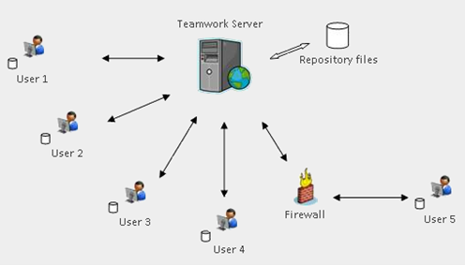
Centralised Version Control

Slide 25
Centralised Version Control
For a centralized version control system there is one single repository that all developers share.
When a developer wants to work on a file he/she checks it out from the central repository.
What happens when two developers work on the same file? Two ways to handle this:
Locking - The first person to check out the file has a lock on the file. That way prevents a later person from modifying the file at the same time
Merging – The second person who checks in the file needs to merge his/her changes with the changes checked in by the previous person.
Notes:
Every commit pushed to the server requires a new version of the entire repository, including the unchanged files. Pushing a commit may require both the server and client to update before the commit can go through. This is necessary in cases where a locally changed file has a newer revision on the server.
The above scenario is very likely when two or more developers are working on the same file and are committing changes to it frequently.

Slide 26
Centralised Version Control
Notes:
The changes to the files are added as deltas into the repository.Storing just the changes (deltas) is more space efficient compared to storing entire new files.
●Each set of changes checked into the repository forms a new version of the repository

Slide 27
Problems with Centralised Version Control
The entire project is stored only at the central server.
If the central server dies you lose everything
You can not work when there is no connection to the central server
You cannot create different versions of your files without contacting the server.

Slide 28
Distributed Version Control
Distributed Teams
As software development has become more team-based, and teams have become more distributed, the need for distributed version control systems has emerged.
No centralized repository
In distributed version control, there is no centralized repository, team members don’t check out individual files from these systems, they check out the entire repository.

Slide 29
Distributed Version Control
The repository is not locked
other team members can also download the current version of a project.
Different snapshots over time
Later, when a team member check the project back in, it is marked as a different version in the repository. Thus, you can think of distributed version control systems as storing different snapshots of a project over time.
Owner determines what and how to merge
It is up to the owner of the repository to merge different version together if he/she so chooses.

Slide 30
Distributed Version Control

Slide 31
Distributed Version Control
Although each developer has his/her own copy of the repository. There is the idea of one person who is the owner of the repository.
The owner is responsible for merging all the changes from all the different developers.
A developer can push his/her changes to another developers repository.
A developer can also pull in changes from another developers repository.

Slide 32
Distributed Version Control
Notes:
Each version of the repository is an entire snapshot of all the files of a repository.
The key benefit of distributed version control over central version control is that a developer can work on the repository (check in and check out files)without internet access.
Using central version control if you have no internet access and want to make a new version of a file you will need to manually make a new copy of the file.
Central version control does allow local version control if the server is another machine.
●One important benefit for a distributed version control system is that every developer has a copy of the entire repository. So if the data from one machine is lost we can always get it back from repositories stored by one of the developers.In contrast for centralized version control if the central repository is lost then all is lost. No developer would have a complete copy of the repository with all its versions.
●The downside is that distributed version control is more complex to learn than central version control.
●Many of the points for this side is taken from http://stackoverflow.com/questions/871/why-is-git-better-than-subversion

Slide 33
Implementation of Version Control Systems
Centralised
Apache Subversion
The most popular centralized version control system(CVCS) on the market
Distributed
Git
The most widely used modern distributed version control system in the world

Slide 34
Apache Subversion (SVN)
Work is comprised of three parts:
Trunk: The trunk is the hub of your current, stable code and product. It only includes tested, unbroken code. This acts as a base where all changes are made from.
Branches: Here is where you house new code and features. Using a copy of the trunk code, team members conduct research and development in the branch. Doing so allows each team member to work on the enhanced features without disrupting each other’s progress.
Tags: Consider tags a duplicate of a branch at a given point in time. Tags are not used during development, but rather during deployment after the branch’s code is finished. Marking your code with tags makes it easy to review and, if necessary, revert your code.

Slide 35
Apache Subversion (SVN)
Every commit pushed to the server requires a new version of the entire repository, including the unchanged files. Pushing a commit may require both the server and client to update before the commit can go through. This is necessary in cases where a locally changed file has a newer revision on the server.
The above scenario is very likely when two or more developers are working on the same file and are committing changes to it frequently.

Slide 36
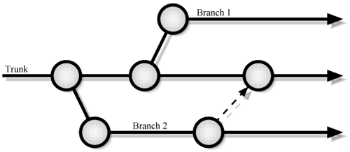
Apache Subversion (SVN)
SVN adopts the concept of 'branches' to isolate any code experiments or incomplete features and uses tags for code snapshotting.
SVN also enables you to quickly retrieve versions of a code repository through the checkout process.
SVN also doesn’t support nested repositories.
Subversion fails to provide the capability to visualize a complex branching tree like this.

Slide 37
Git
Each developer will be working with their local version of the repository instead of the central repo.
Does not reply on active connection
Commits are made to the local repositories before the changes are pushed to the central server.

Slide 38
Git – Conflict Resolution
In the scenario when two developers want to push their changes on the same file to the central repo, git will compare the current snapshot with the committed snapshot and allow the developer with the most updated snapshot to push changes to the repo. The changes made by the other developer are not lost. Git will instruct the developer whose push was rejected to first pull the latest changes from the central repository before pushing his/her/they changes. So, at any given point, the central repository will always hold the most up to date code.

Slide 39
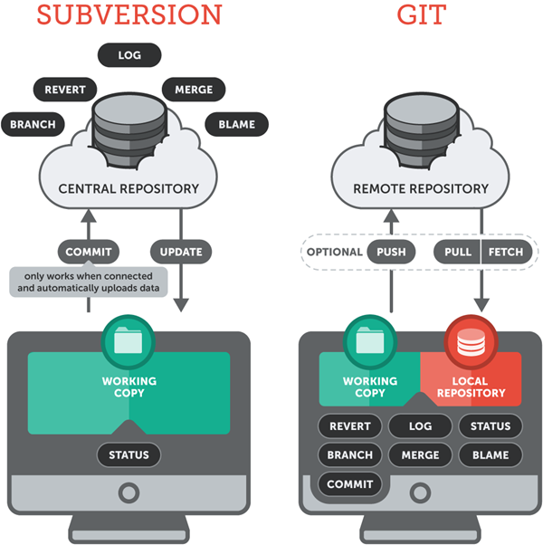
VCN Comparison
https://www.git-tower.com/learn/git/ebook/en/desktop-gui/appendix/from-subversion-to-git/

Slide 40
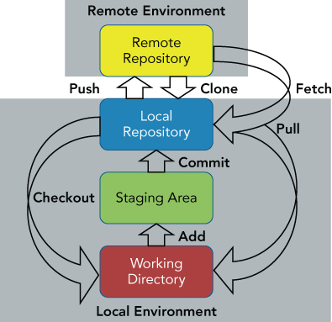
Basic Workflow
https://www.atlassian.com/git/tutorials/using-branches/git-checkout
https://kelvinleong.github.io/git/2017/01/20/Use-Git.html
Notes:
The git checkout command lets you navigate between the branches created by git branch. Checking out a branch updates the files in the working directory to match the version stored in that branch, and it tells Git to record all new commits on that branch. Think of it as a way to select which line of development you’re working on.
https://www.atlassian.com/git/tutorials/using-branches/git-checkout
Working directory
This is the current directory with the files you are working on.
Staging area
Here is where you create an index of the files that you want to commit later.
You can add a file to the staging area as follows:
$ git add animation.java
You can select the files you want to add one at a time and put them into the staging area.
Git directory (repository)
Once you are ready you can commit all files in the staging area into the repository
$ git commit -m “changed animation code”
●Modify files in your working directory.
●Stage files, adding snapshots of them to your staging area.
●Do a commit, which takes the files as they are in the staging area and stores that snapshot permanently to your Git directory.
●If a particular version of a file is in the git directory, it’s considered committed.
●If it’s modified but has been added to the staging area, it is staged.
●If it was changed since it was checked out but has not been staged, it is modified.

Slide 41
Committing all files in a directory at once
There are two ways of committing the entire directory
Using staging area
gitadd .
gitcommit -m “made big change”
Directly commit into repository bypassing the staging area
gitcommit -a -m “made big change”

Slide 42
Setting up Git
Follow the tutorial in LMS
Set the name and email for Gitto use when you commit:
$ gitconfig--global user.name“Bugs Bunny”
$ gitconfig--global user.emailstudent@gmail.com
You can call git config–list to verify these are set.
These will be set globally for all Git projects you work with.
You can also set variables on a project-only basis by not using the --global flag.

Slide 43
Creating and Using a Repository
To create a Gitrepo in your current directory:
$ git init
This will create a .git directory in your current directory.
Then you can commit files in that directory into the repo by first adding to the staging area and then committing into the repo:
$ git add file1.java
$ git commit –m “initial project version”
You can use the following to unstage a file
$ git reset HEAD file1.java
You can get back the original version of a file that you have modified using the following
$ git checkout file1.java

Slide 44
Creating New Branches
Git allows you to diverge from the main line of development.
Allows you to work without messing up the main line of code.
Better than creating a new copy of your source code directory for each new branch.
Main development branch = master.
New versions may be created along the master branch, or new branches can be created off of it.
The changes to the new branches will be tracked independently.
The branches can possibly be merged back into the master branch.

Slide 45
Git Branching
In this example there is a master branch which only contains production versions of the code
Production code is code that is actually used to serve customers. It is usually heavily tested code.
The other branch is the develop branch that is used by the developer to work on development version of the code
When the code is of production quality it is merged into the master branch.
The owner controls what goes into the master branch.

Slide 46
Checkout and merging a branch
To create a branch called develop
$ git branch develop
To list all branches (* shows which one you are currently on)
$ git branch
To switch to the develop branch
$ git checkout develop
To switch back to the master branch and then merge the changes from the develop branch do the following
$ git checkout master
$ git merge develop

Slide 47
Forking
You may really like an open source Gitproject and want to make a lot of changes to it.
Also your changes may not be wanted by other people. Therefore the owner of the original Git repository may not want to merge your changes to the open source project.
In this case you can fork the project.
This will clone the entire project into a new project.
You can then have full control of the forked project.
From here on if you want to push changes back to the original repository that will be hard.

Slide 48
Remote Git Repository
In order to have multiple developers working on the same repository we need to create a remote git repository.
Developers push their change to the remote repository
We can clone or pull the data from a remote repository into our working directory.

Slide 49
Create and Push to Remote Repository
Lets assume you have already created a local git repository.
Now here is how you can add the remote repository
$ git remote add origin <Remote URL>
Here originis the name you give to the remote repository. After this command every where you use origin it will refer to the remote repository located at the URL specified by <Remote URL>.
<Remote URL> is the URL where the remote repository is located.
Once you add the remote repository you can now push your local repository into the remote repository using the following
$ git push –u origin master
This pushes the master branch to the remote repository named origin.

Slide 50
Getting files from Remote Repository (fetch, pull and clone)
The fetch command can be used to grab all the data from a remote repository
$ git fetch <remote-name>
To use the above command you need to first add the remote repository into your local repository.
If you want gitto create a local repository and also grab all the data from the remote repository in one command you can use cloneinstead
$ git clone <remote URL>
This will clone the repository stored at <remote URL>
If you already have a copy of the remote repository but just want to update it with the latest version you can use pull
$ git pull <remote-name>
This will update the current local gitwith the remote repository specified by <remote-name>

Slide 51
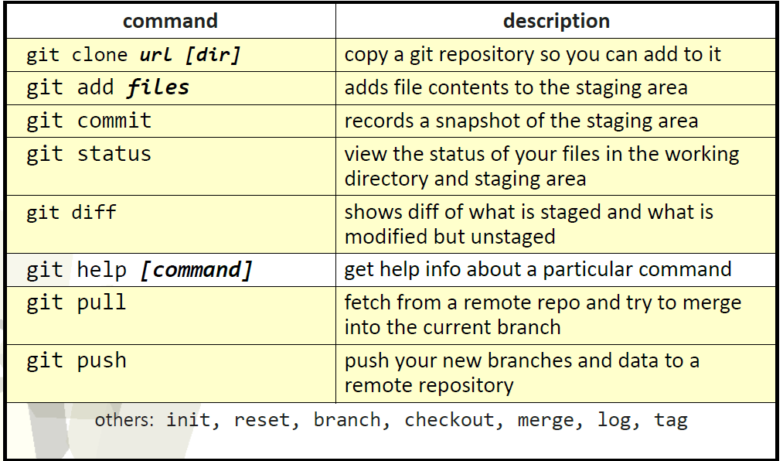
Git commands (MUST MEMORISE ALL OF THEM)

Slide 52
Thank You

